Slide 1

8 Week SQL Challenge Case Study #1 - Danny's Diner

Slide 2
Problem Statement
Danny wants to use the data to answer a few simple questions about his customers, especially about their visiting patterns, how much money they’ve spent and also which menu items are their favourite. Having this deeper connection with his customers will help him deliver a better and more personalised experience for his loyal customers.
He plans on using these insights to help him decide whether he should expand the existing customer loyalty program - additionally he needs help to generate some basic datasets so his team can easily inspect the data without needing to use SQL.
Danny has provided you with a sample of his overall customer data due to privacy issues - but he hopes that these examples are enough for you to write fully functioning SQL queries to help him answer his questions. Danny has shared with you 3 key datasets for this case study:
sales
menu
members

Slide 3
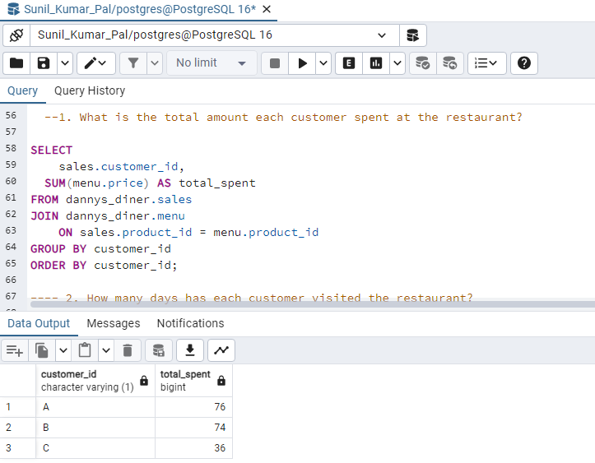
1.What is the total amount each customer spent at the restaurant?

Slide 4
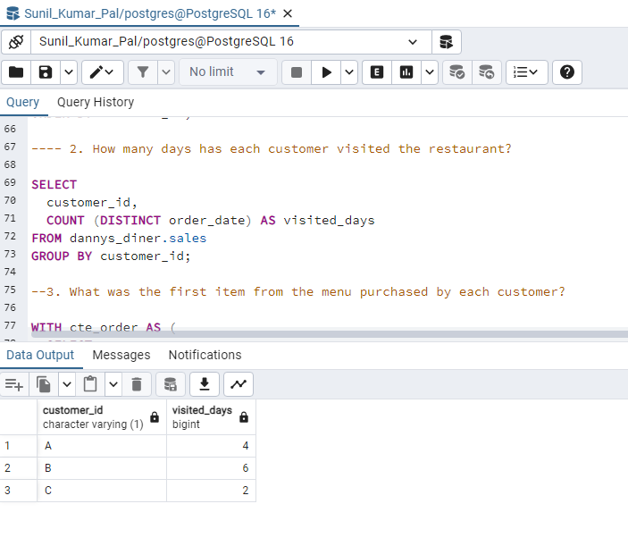
2. How many days has each customer visited the restaurant

Slide 5
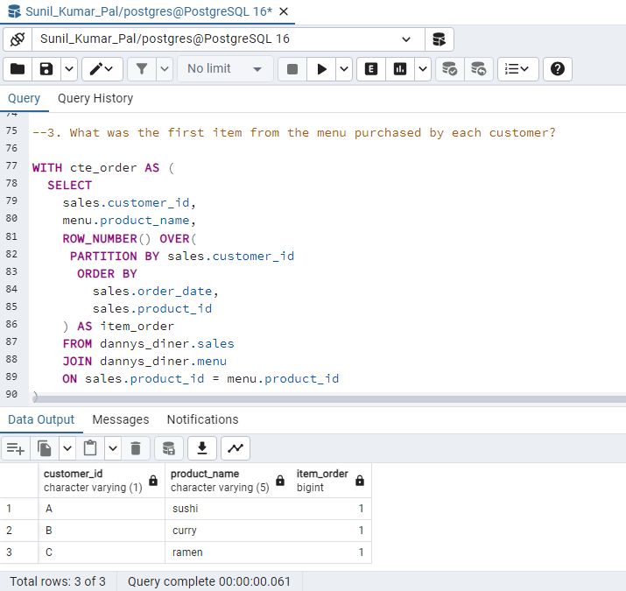
3. What was the first item from the menu purchased by each customer

Slide 6
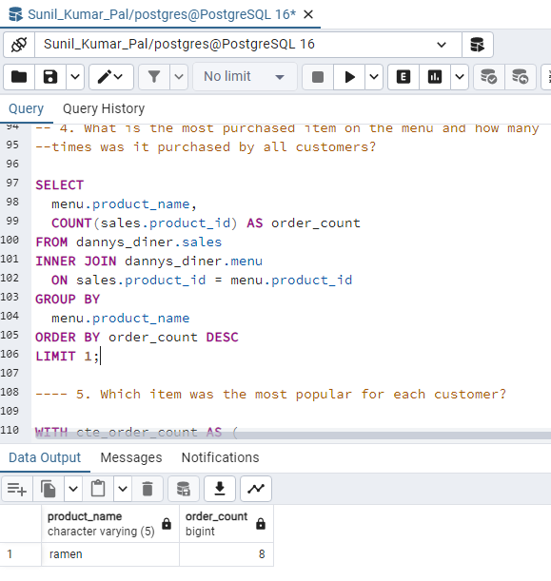
4. What is the most purchased item on the menu and how many times was it purchased by all customers?

Slide 7
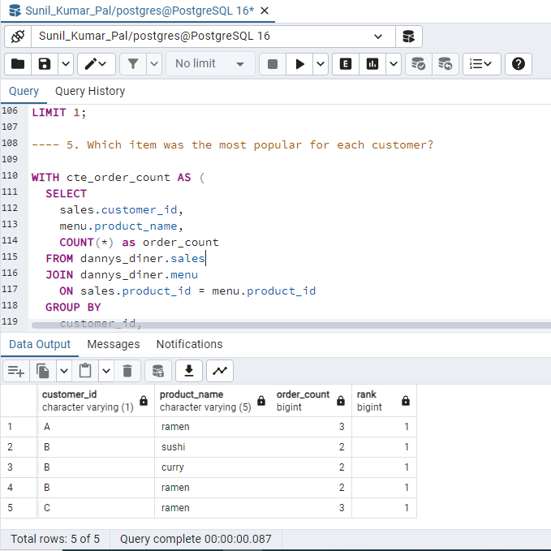
5. Which item was the most popular for each customer?

Slide 8
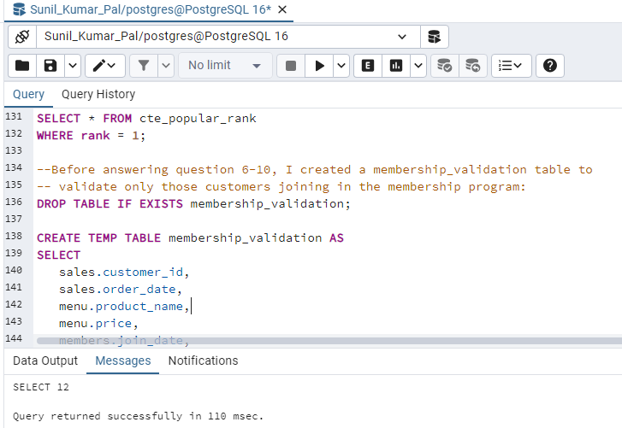
Before answering question 6-10, I created a membership_validation table to validate only those customers joining in the membership program:

Slide 9
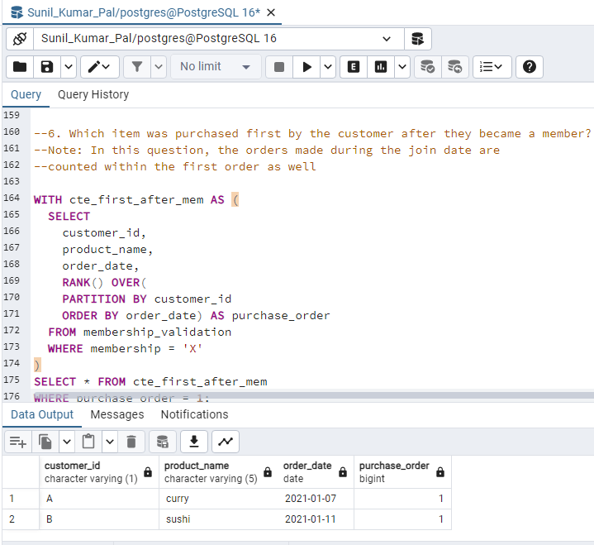
6. Which item was purchased first by the customer after they became a member? Note: In this question, the orders made during the join date are counted within the first order as well

Slide 10
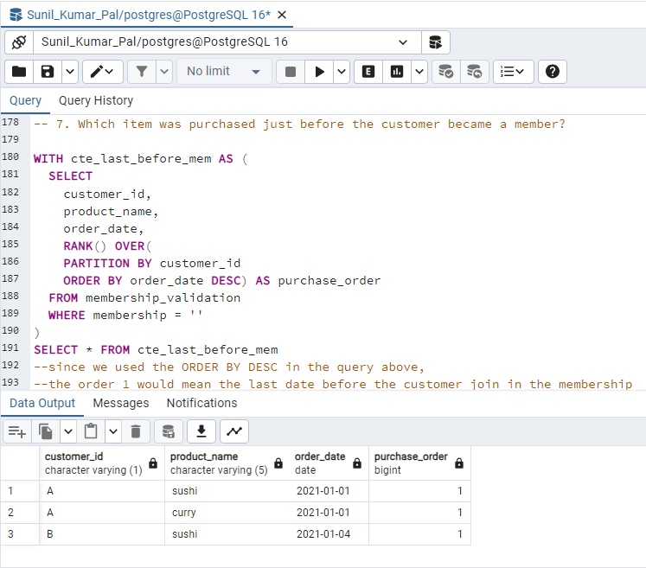
7. Which item was purchased just before the customer became a member?

Slide 11
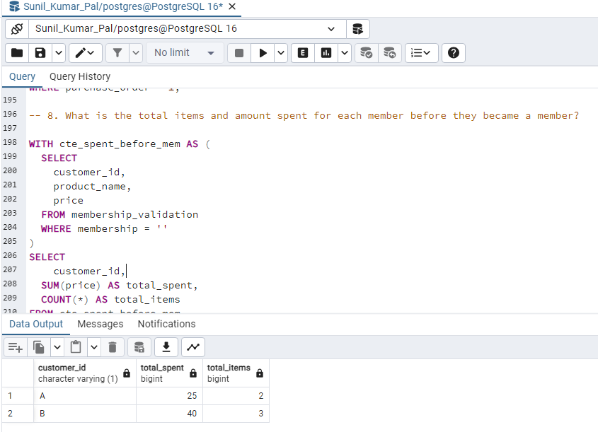
8. What is the total items and amount spent for each member before they became a member?

Slide 12
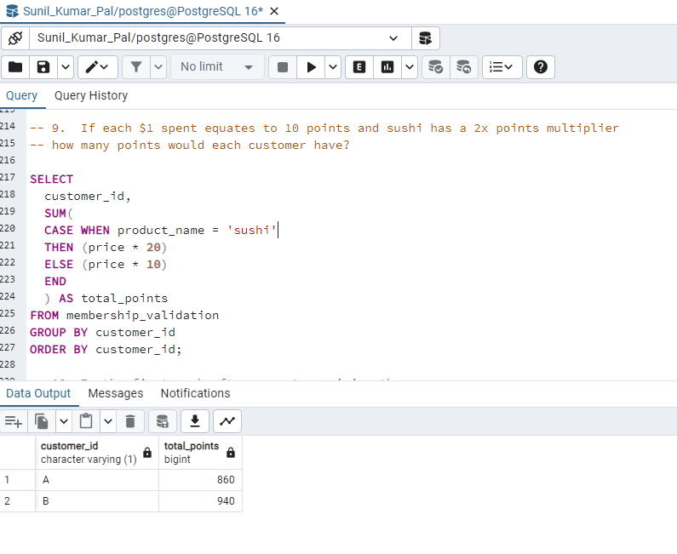
9.If each $1 spent equates to 10 points and sushi has a 2x points multiplier how many points would each customer have?

Slide 13
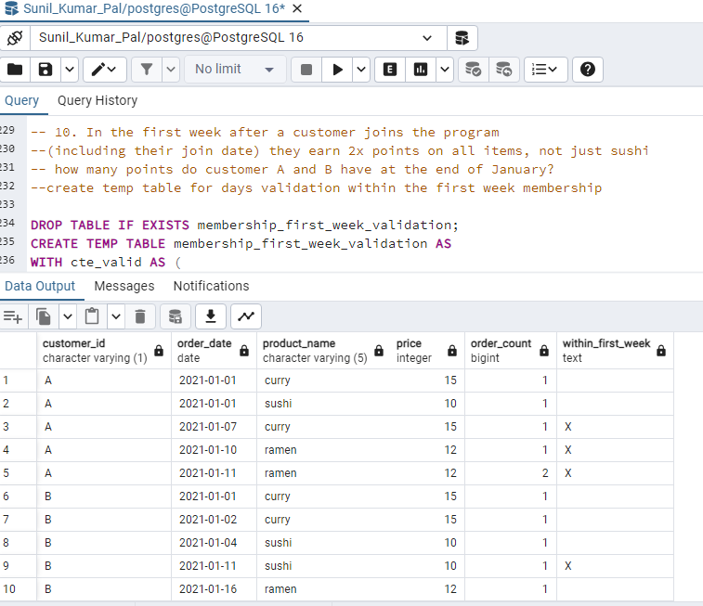
10. In the first week after a customer joins the program (including their join date) they earn 2x points on all items, not just sushi how many points do customer A and B have at the end of January? create temp table for days validation within the first week membership

